Slide 1

Identifying needs and establishing requirements

Slide 2

Overview
The importance of requirements
Different types of requirements
Data gathering
Task descriptions: Scenarios
Use Cases
Essential use cases
Task analysis: HTA

Slide 3
What, how and why?
What
  Two aims:
  1. Understand as much as possible about users, task, context
  2. Produce a stable set of requirements
How:
  Data gathering activities
  Data analysis activities
  Expression as ‘requirements’
  All of this is iterative

Slide 4
What, how and why?
Why:
  Requirements definition: the stage where failure occurs most commonly
  Getting requirements right is crucial

Slide 5
Establishing requirements
What do users want? What do users ‘need’?
  Requirements need clarification, refinement, completion, re-scoping
  Input: requirements document (maybe)
  Output: stable requirements
Why ‘establish’?
  Requirements arise from understanding users’ needs
  Requirements can be justified & related to data

Slide 6
Different kinds of requirements
Functional:
    What the system should do
    Historically the main focus of requirements activities
(Non-functional: memory size, response time... )
Data:
    What kinds of data need to be stored?
    How will they be stored (e.g. database)?

Slide 7
Different kinds of requirements
Environment or context of use:
    physical: dusty? noisy? vibration? light? heat? humidity? …. (e.g. OMS insects, ATM)
    social: sharing of files, of displays, in paper, across great distances, work individually, privacy for clients
    organisational: hierarchy, IT department’s attitude and remit, user support, communications structure and infrastructure, availability of training

Slide 8
Different kinds of requirements
Users: Who are they?
  Characteristics: ability, background,
  attitude to computers
  System use: novice, expert, casual, frequent
  Novice: step-by-step (prompted), constrained, clear information
  Expert: flexibility, access/power
  Frequent: short cuts
  Casual/infrequent: clear instructions, e.g. menu paths

Slide 9
Different kinds of requirements
Usability:
learnability, throughput, flexibility,
attitude
Note that user requirements and usability requirements refer to different things

Slide 10
Kinds of requirements
What factors (environmental, user, usability) would affect the following systems?
Self-service filling and payment system for a petrol (gas) station
On-board ship data analysis system for geologists searching for oil
Fashion clothes website

Slide 11
Data gathering techniques (1)
Questionnaires:
  A series of questions designed to elicit
  specific information
  Questions may require different kinds of
  answers:
  simple YES/NO; choice of pre-supplied
  answers; comment
  Often used in conjunction with other
  techniques
  Can give quantitative or qualitative data
  Good for answering specific questions from
  a large, dispersed group of people

Slide 12
Data gathering techniques (2)
Interviews:
  Forum for talking to people
  Structured, unstructured or semi-structured
  Props, e.g. sample scenarios of use,
  prototypes, can be used in interviews
  Good for exploring issues
  But are time consuming and may be
  infeasible to visit everyone

Slide 13
Data gathering techniques (3)
Workshops or focus groups:
  Group interviews
  Good at gaining a consensus view and/or
  highlighting areas of conflict

Slide 14
Data gathering techniques (4)
Naturalistic observation:
  Spend time with stakeholders in their day-to-day tasks, observing work as it
  happens
  Gain insights into stakeholders’ tasks
  Good for understanding the nature and
  context of the tasks
  But, it requires time and commitment
  from a member of the design team, and
  it can result in a huge amount of data
  Ethnography is one form

Slide 15
Data gathering techniques (5)
Studying documentation:
  Procedures and rules are often written
  down in manuals
  Good source of data about the steps
  involved in an activity, and any
  regulations governing a task
  Not to be used in isolation
  Good for understanding legislation, and
  getting background information
  No stakeholder time, which is a limiting
  factor on the other techniques

Slide 16
Choosing between techniques
Data gathering techniques differ in two ways:
  1. Amount of time, level of detail and risk associated with the findings
  2. Knowledge the analyst requires
The choice of technique is also affected by the kind of task to be studied:
  Sequential steps or overlapping series of subtasks?
  High or low, complex or simple information?
  Task for a layman or a skilled practitioner?

Slide 17
Problems with data gathering (1)
Identifying and involving stakeholders:
users, managers, developers, customer reps?, union reps?, shareholders?
Involving stakeholders: workshops, interviews, workplace studies, co-opt stakeholders onto the development team
‘Real’ users, not managers:
traditionally a problem in software engineering, but better now

Slide 18
Problems with data gathering (2)
Requirements management: version control, ownership
Communication between parties:
    within development team
    with customer/user
    between users… different parts of an organisation use different terminology
Domain knowledge distributed and implicit:
    difficult to dig up and understand
    knowledge articulation: how do you walk?
Availability of key people

Slide 19
Problems with data gathering (3)
Political problems within the organisation
Dominance of certain stakeholders
Economic and business environment changes
Balancing functional and usability demands

Slide 20
Some basic guidelines
Focus on identifying the stakeholders’ needs
Involve all the stakeholder groups
Involve more than one representative from each stakeholder group
Use a combination of data gathering techniques

Slide 21
Some basic guidelines
Support the process with props such as prototypes and task descriptions
Run a pilot session
You will need to compromise on the data you collect and the analysis to be done, but before you can make sensible compromises, you need to know what you’d really like
Consider carefully how to record the data

Slide 22
Data interpretation and analysis
Start soon after data gathering session
Initial interpretation before deeper analysis
Different approaches emphasize different elements e.g. class diagrams for object-oriented systems, entity-relationship diagrams for data intensive systems

Slide 23
Task descriptions
Scenarios
  an informal narrative story, simple, ‘natural’, personal, not generalisable
Use cases
  assume interaction with a system
  assume detailed understanding of the interaction
Essential use cases
  abstract away from the details
  does not have the same assumptions as use cases

Slide 24
Scenario for shared calendar
“The user types in all the names of the meeting participants together with some constraints such as the length of the meeting, roughly when the meeting needs to take place, and possibly where it needs to take place. The system then checks against the individuals’ calendars and the central departmental calendar and presents the user with a series of dates on which everyone is free all at the same time. Then the meeting could be confirmed and written into people’s calendars. Some people, though, will want to be asked before the calendar entry is made. Perhaps the system could email them automatically and ask that it be confirmed before it is written in.”

Slide 25
Use case for shared calendar
1. The user chooses the option to arrange a meeting.
2. The system prompts user for the names of attendees.
3. The user types in a list of names.
4. The system checks that the list is valid.
5. The system prompts the user for meeting constraints.
6. The user types in meeting constraints.
7. The system searches the calendars for a date that satisfies the constraints.
8. The system displays a list of potential dates.
9. The user chooses one of the dates.
10. The system writes the meeting into the calendar.
11. The system emails all the meeting participants informing them of them appointment

Slide 26
Alternative courses for shared calendar
Some alternative courses:
    5. If the list of people is invalid,
    5.1 The system displays an error
    message.
    5.2 The system returns to step 2.
    8. If no potential dates are found,
        8.1 The system displays a suitable message.
8.2 The system returns to step 5.

Slide 27
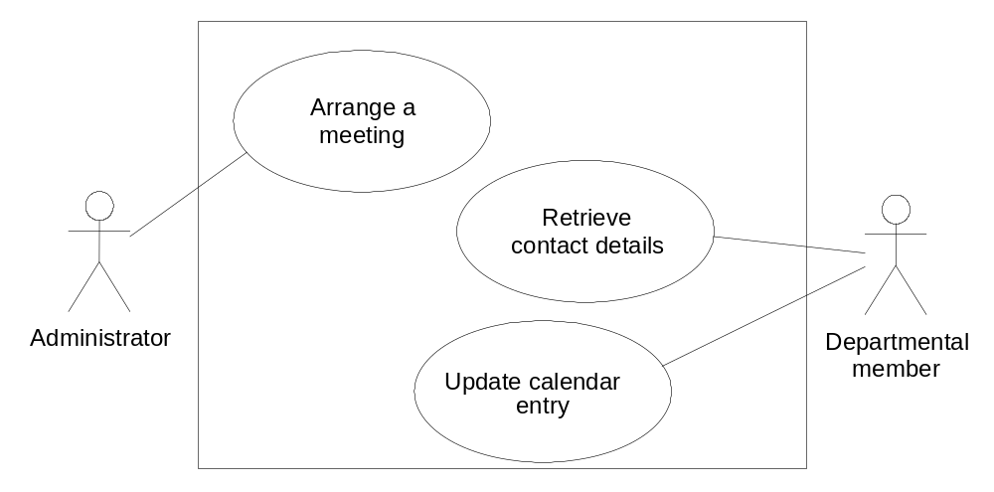
Example use case diagram for shared calendar

Slide 28
Example essential use case for shared calendar
arrangeMeeting
USER INTENTION SYSTEM RESPONSIBILITY
arrange a meeting
request meeting attendees & constraints
identify meeting attendees
& constraints
search calendars for suitable dates
suggest potential dates
choose preferred date
book meeting

Slide 29
Task analysis
Task descriptions are often used to envision new systems or devices
Task analysis is used mainly to investigate an existing situation
It is important not to focus on superficial activities
What are people trying to achieve?
Why are they trying to achieve it?
How are they going about it?
Many techniques, the most popular is Hierarchical Task Analysis (HTA)

Slide 30
Hierarchical Task Analysis
Involves breaking a task down into subtasks, then sub-sub-tasks and so on. These are grouped as plans which specify how the tasks might be performed in practice
HTA focuses on physical and observable actions, and includes looking at actions not related to software or an interaction device
Start with a user goal which is examined and the main tasks for achieving it are identified
Tasks are sub-divided into sub-tasks

Slide 31
Example Hierarchical Task Analysis
0. In order to borrow a book from the library
1. go to the library
2. find the required book
2.1 access library catalogue
2.2 access the search screen
2.3 enter search criteria
2.4 identify required book
2.5 note location
3. go to correct shelf and retrieve book
4. take book to checkout counter

Slide 32
Example Hierarchical Task Analysis (plans)
plan 0: do 1-3-4. If book isn’t on the shelf expected, do 2-3-4.
plan 2: do 2.1-2.4-2.5. If book not identified do 2.2-2.3-2.4.

Slide 33
Example Hierarchical Task Analysis (graphical)
Borrow a book from the library
0
plan 0:
do 1-3-4.
If book isn’t on the shelf expected, do 2-3-4.
go to the library
find required book
retrieve book from shelf
take book to counter
1
2
3
4
plan 2:
do 2.1-2.4-2.5.
If book not identified from information available, do 2.2-2.3-2.4-2.5
access catalog
access search screen
enter search criteria
identify required book
note location
2.1
2.2
2.3
2.4
2.5

Slide 34
Summary
  Getting requirements right is crucial
  There are different kinds of requirement, each is significant for interaction design
  The most commonly-used techniques for data gathering are: questionnaires, interviews, focus groups and workshops, naturalistic observation, studying documentation
  Scenarios, use cases and essential use cases can be used to articulate existing and envisioned work practices.
  Task analysis techniques such as HTA help to investigate existing systems and practices

